Slide 1
Publication Working Team
ESGF F2F December 9, 2015
Sasha Ames (LLNL), Rachana Ananthakrishanan, Lukasz Lacinski (ANL)

Slide 2
Who we are
Developers, expert users, data managers, node administrators, with a common focus on publication-related concerns.
People: Sasha, Rachana, Lukasz, Guillaume (IPSL), Ag, Alan I. (CEDA) Katharina, Hans (DKRZ), Serguei (GFDL), Georgi (NOAA), John H. (ORNL) , Luca (JPL/ESRL), Michael K. (LiU), Claire (ANU)

Slide 3
Major PWT activities
Maintenance and enhancements to esg-publisher script suite
No fundamental changes
Remains cornerstone for following developments
Remote publication services Web UI and API
Poised to expand the publisher user based
Workflow discussion and report (Paris 2015 October code sprint)

Slide 4
Publisher in ESGF 2.x
Compatibility with changes part of the 2.x stack, e.g.. THREDDS recheck, openSSL v1.01
Parallel checksums for map creation
Better support to ingest version tags
Add optional facets to published data sets
Heterogeneous data support within a project (for ACME)
Non-netCDF files
Esg.ini (master publisher config) file defaults cleanup
Thanks to Katharina for many of these contributions

Slide 5
Publication workflow at IS-ENES
Comprehensive CMIP6 workflow documentation with stakeholder/participant identification
Recommendation of changes to publisher tool
Best practices for publisher operations
PGSQL schema updates for errata and PID integration
Design of publication test suite (CEDA)
Consistency checks
Various granularities
Publishing and unpublishing
Parallel publication testing

Slide 6
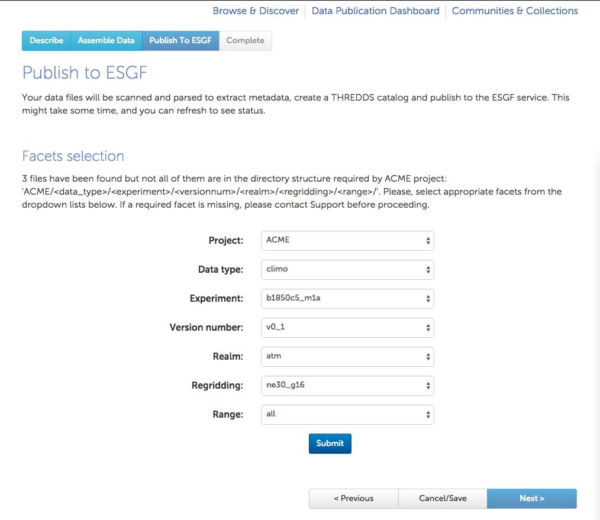
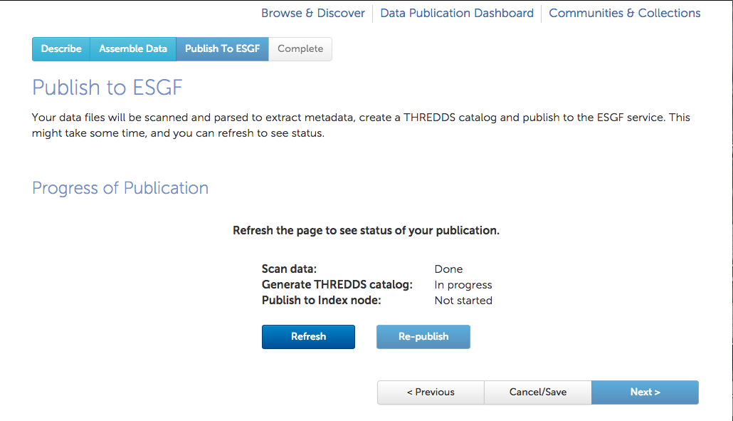
Dataset Ingestion Service via Web UI
See http://acme.globuscs.info/
Publication workflow:
User chooses data node to publish to and sets searchable metadata (facets)
Submits publication and is notified of status
Service
Transfer datasets from compute resources to the ESGF data node
Scan transferred files, generate THREDDS catalog, publish to Solr
Status update on the web UI and email notification to users
Used by ACME project
Published the amip ne30 and ne120 datasets - about 25 TB of data
Talk to Lukasz for demos

Slide 7
Service via Rest API
Multiple publication workflows:
Publish data already stored on the data node
Transfer and publish datasets
Unpublish datasets
Additional Features:
Selecting files to publish using glob patterns
Adding new facet values
Client Python module and sample REST API client

Slide 8
Work Planned for Pub Services
Integrate with COG for UI publication to be a feature of COG
Add replicated data publication as a first class flow
Facet management and esg.ini files
Dataset versioning

Slide 9
What’s next for PWT
Understand and reflect changes in granularity: file, variable, ensemble, etc. wrt PID
Multiple directory-format support for single project via xml configuration format vs multiple esg.ini
Changes to support CMIP6 workflow
PID management
Errata services integration
Implementation of publication test suite, integration with other ESGF software tests, and community adoption
Project-specific QC integration – work with QCWT
Easy case – data went through CMOR adequate test?
More Service users for various projects, please!

